Slide 1
Data Science Processes Tools to Improve Understanding
Craig Savage, PhD, MBA
23 April 2020

Slide 2
Disclosures

Slide 3
Introduction: Personal and Talk
Start at the beginning, it’s an awfully good place to start

Slide 4
Personal Introduction
Education in technical fields and business
PhD in Electrical Engineering and MBA
Over 20 years experience in industry:
Defence
Biomedical Engineering
Banking (Risk)
Motivated by implementation of systems
Flight tests
Patient trials
Customer assessment
Goal is to have a measurable impact

Slide 5
Inspiration
Watching Gruen Transfer (https://iview.abc.net.au/show/gruen)
Host Todd Sampson says (something like):
“We don’t think about 80% of the decisions we make.”
[Based on US research – more specifically that emotions drive 80% of decisions]
[Other research shows 90%, or even 95% (!), of purchasing decisions]
I’ve told people that – they mull it over for a bit and make a quick judgment
…that is, they made a decisions without really thinking about it!

Slide 6

Inspiration
Watching Gruen Transfer (https://iview.abc.net.au/show/gruen)
Host Todd Sampson says (something like):
“We don’t think about 80% of the decisions we make.”
[Based on US research – more specifically that emotions drive 80% of decisions]
[Other research shows 90%, or even 95%!]
I’ve told people that – they mull it over for a bit and make a quick judgment
…that is, they made a decisions without really thinking about it!

Slide 7
Inspiration
Watching Gruen Transfer (https://iview.abc.net.au/show/gruen)
Host Todd Sampson says (something like):
“We don’t think about 80% of the decisions we make.”
[Based on US research – more specifically that emotions drive 80% of decisions]
[Other research shows 90%, or even 95%!]
I’ve told people that – they mull it over for a bit and make a quick judgment
…that is, they made a decisions without really thinking about it!
Provide framework to think about data science in a business context

Slide 8
Overview
Provide introduction to processes
Definitions
Conventions
Resources
Applications to data science
Include tips from studying data science processes to highlight potential project issues
Leverage experience from different organisations and disciplines
Focus on application of data science tools and techniques to processes

Slide 9
Introduction to Processes

Slide 10
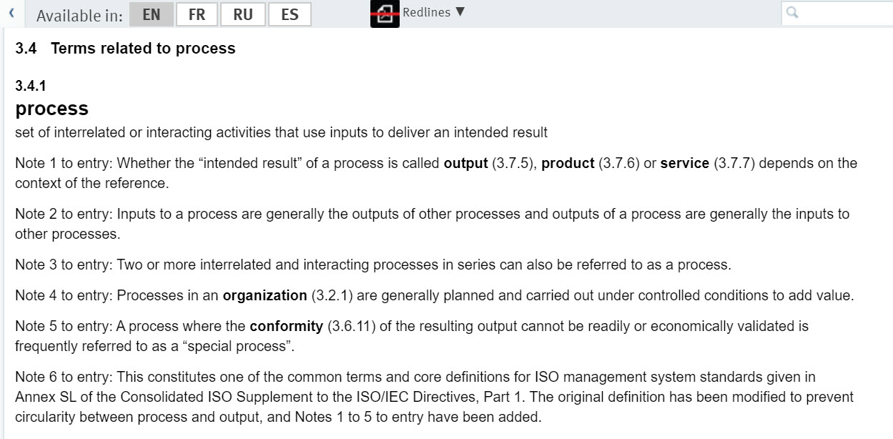
Introduction: ISO
International Standards Organization (ISO)
Core term
Definition notes:
Process of processes
Inputs/outputs
“Special Process”
Data Science
https://www.iso.org/obp/ui/#iso:std:iso:9000:ed-4:v1:en

Slide 11
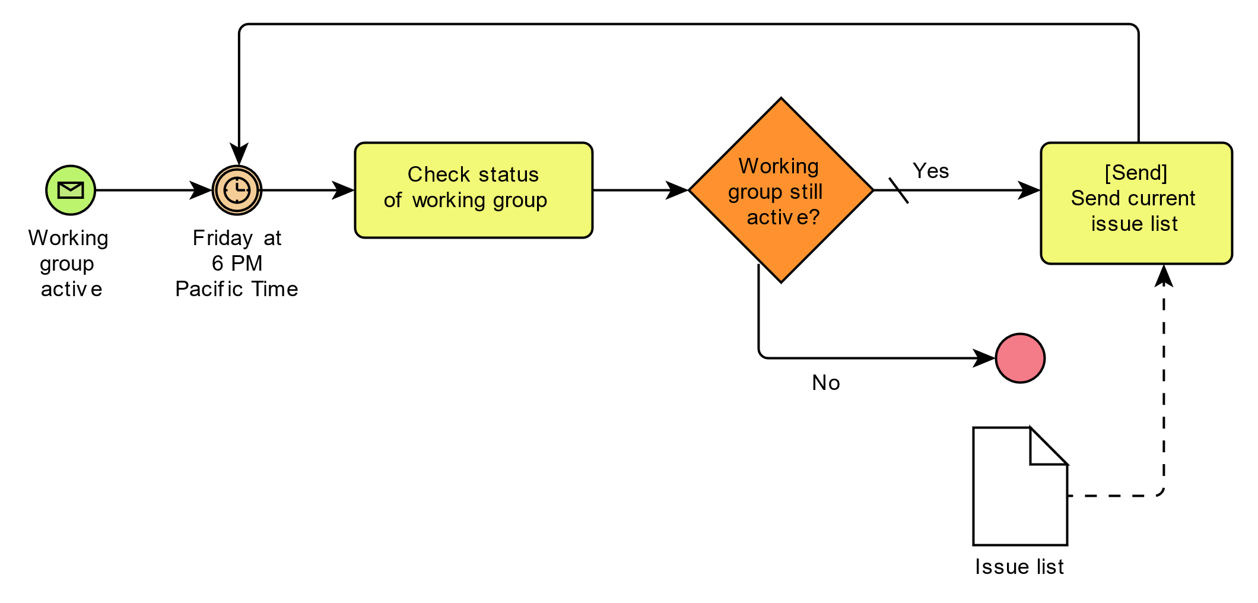
Introduction: Illustrating Processes
Business Process Model (and) Notation - BPMN
Shapes, structures
Accountability
Others (EPC, BPEL, …)
Other systems follow similar structures
Data Flow Diagrams
Architecture Diagrams
Control Diagrams
Decision Trees
By BPMN-AProcesswithNormalFlow.jpg: Tttt1234derivative work: Rehua (talk) - This file was derived from: BPMN-AProcesswithNormalFlow.jpg:, Public Domain, https://commons.wikimedia.org/w/index.php?curid=18126163

Slide 12
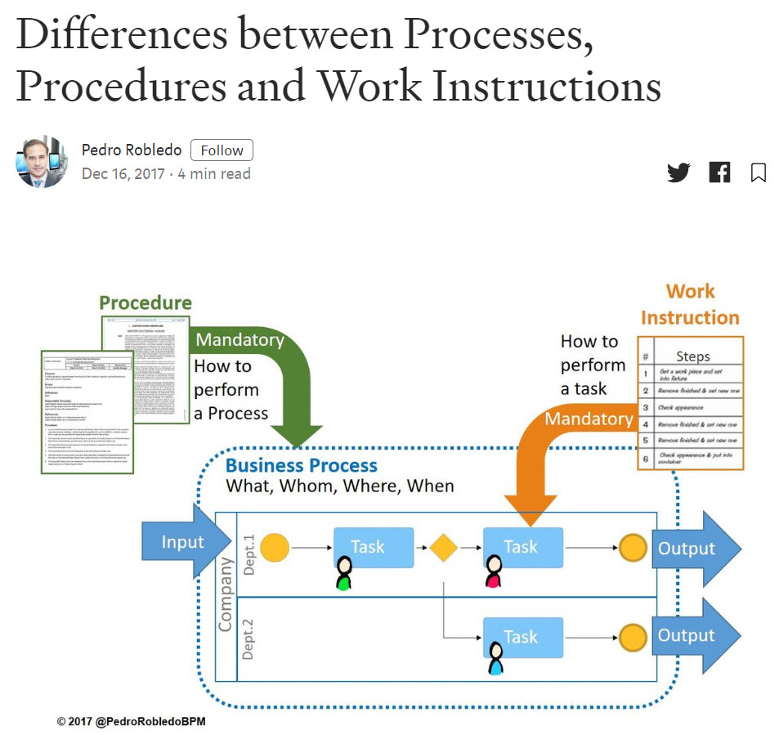
Introduction: Related Terms
Process, Procedure, Work Instructions
Process is highest level
Often Conceptual
Procedures describe performing a process
Work Instructions describe performing a task
Procedure and Work Instructions are mandatory
Trackable
https://medium.com/@pedrorobledobpm/differences-between-processes-procedures-and-work-instructions-fd64ef2946f5

Slide 13
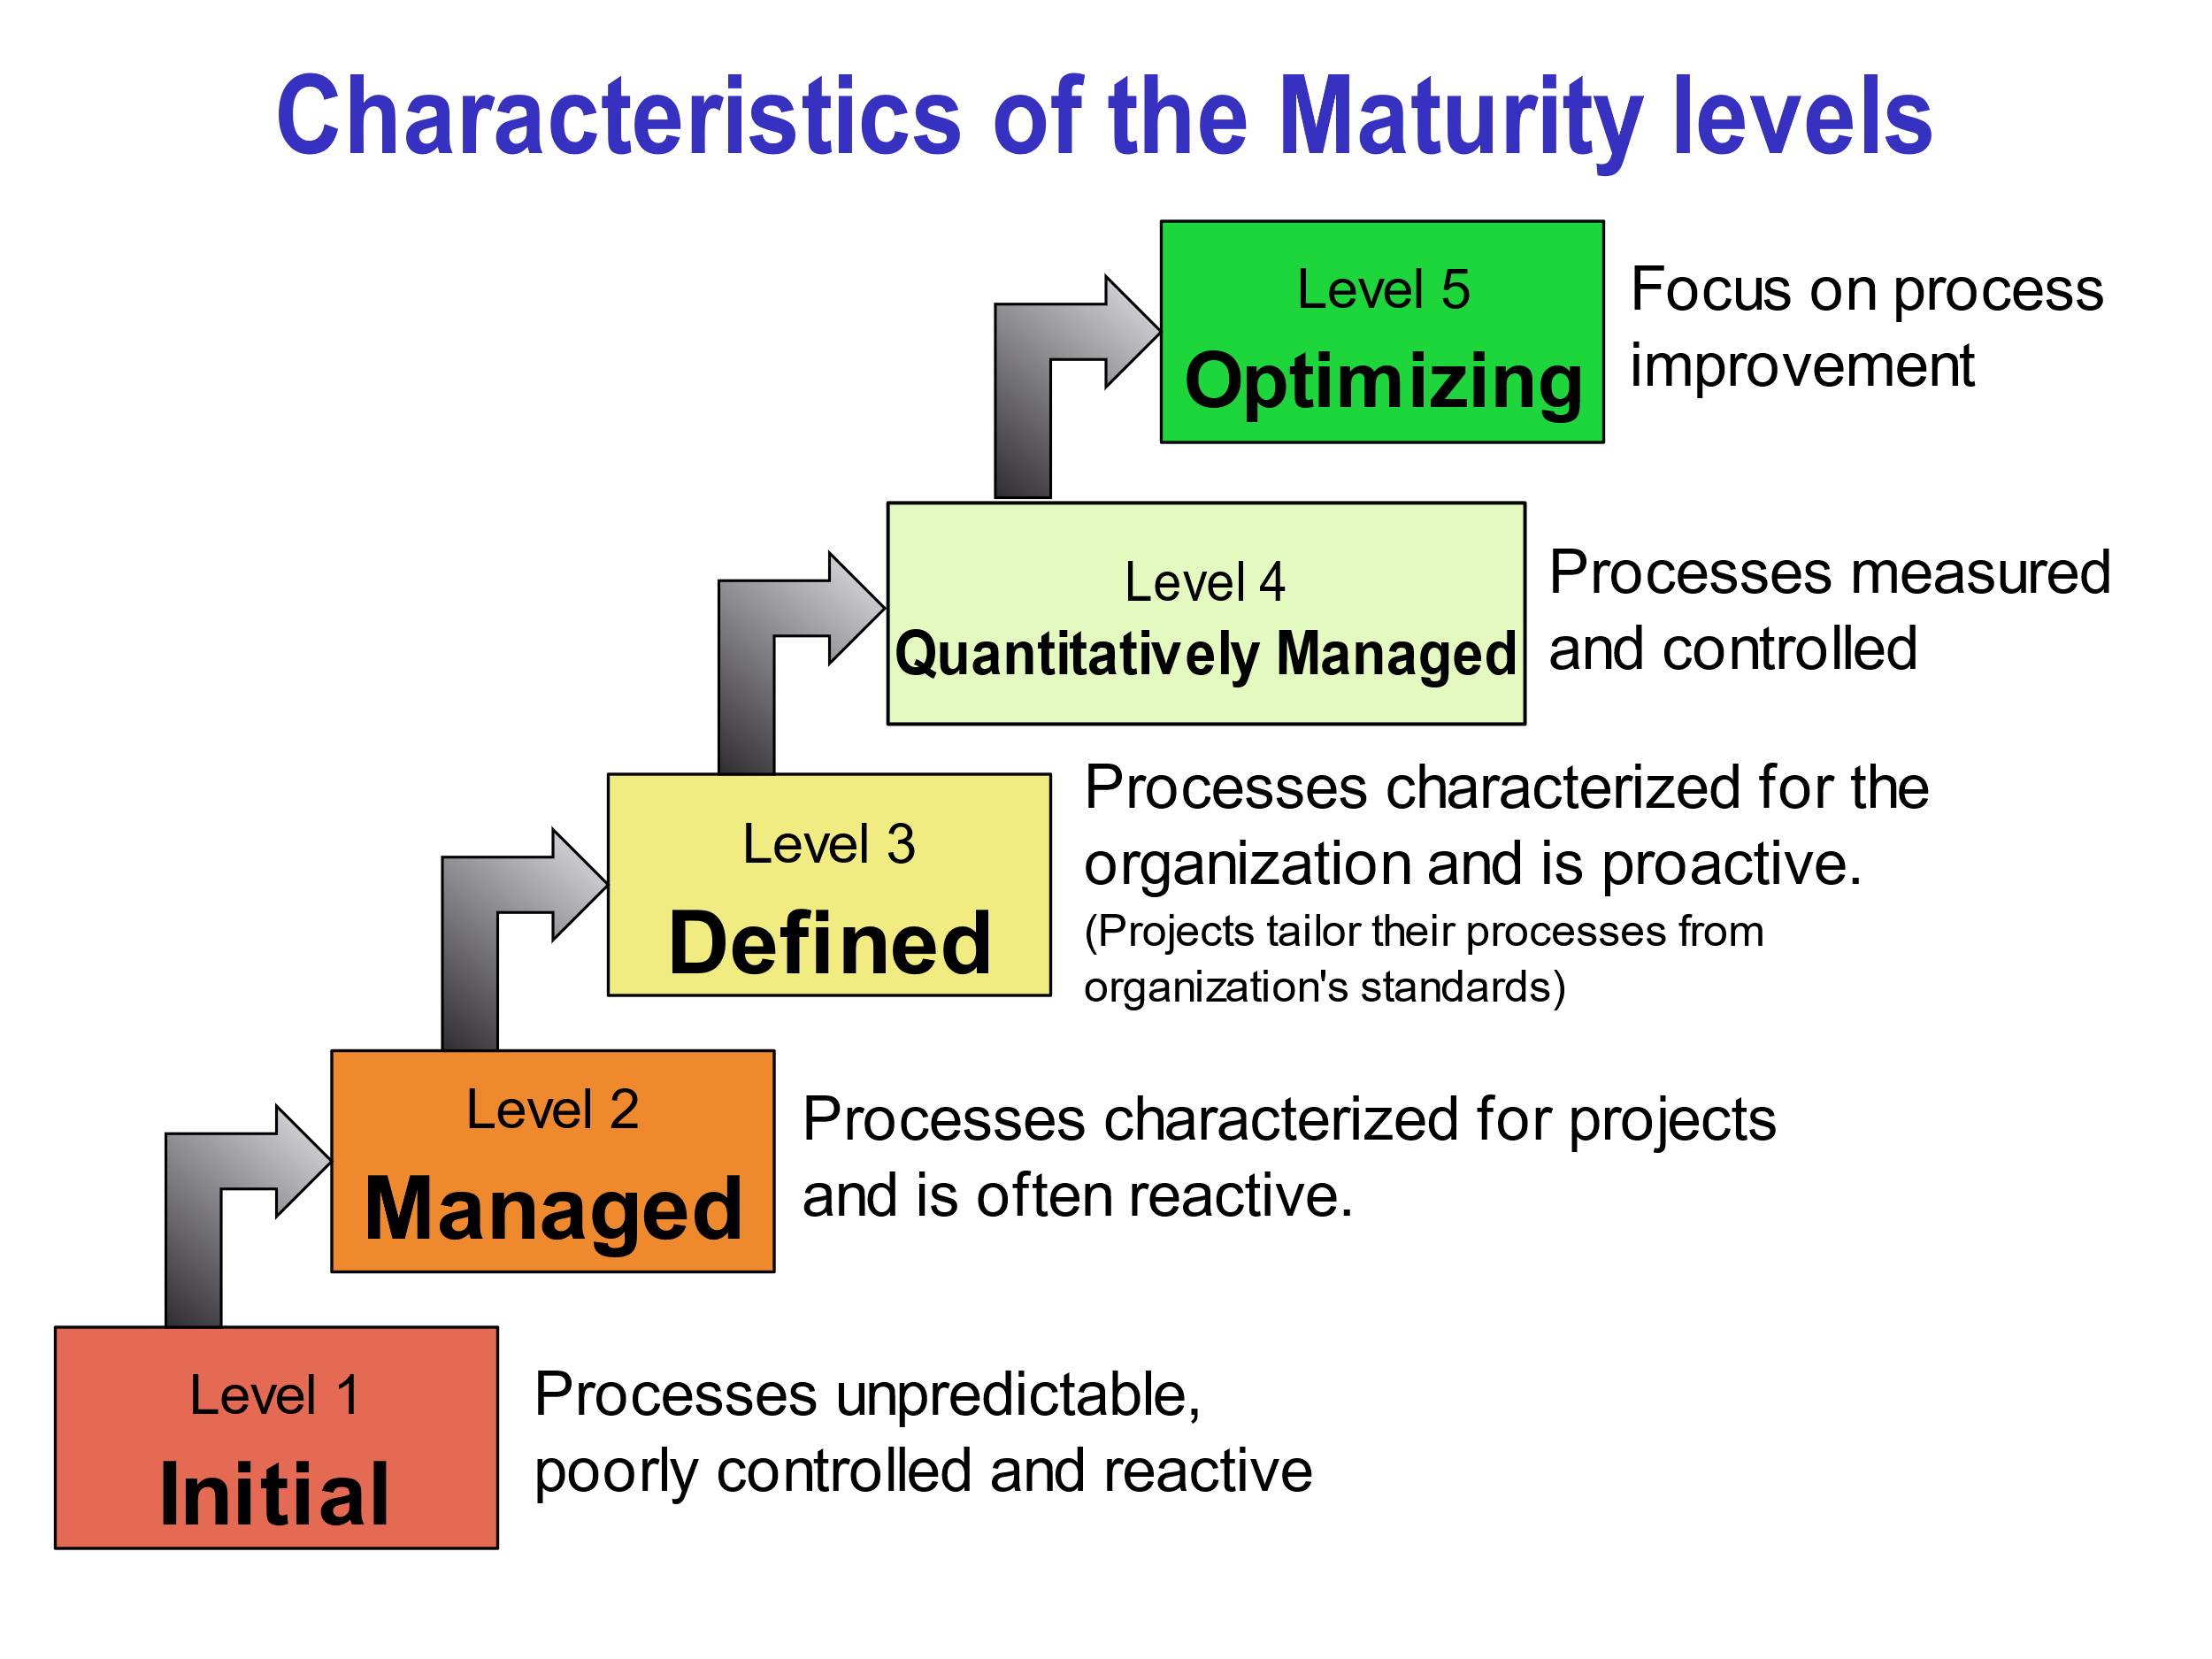
Introduction: Process Maturity
CMMI – Capability Maturity Model Integration
Levels 1 to 5
Not a judgment! Data Science often exploratory, loose processes
Audits/Evaluation
Documentation:
Real?
Maintained?
By Sally Godfrey - What is CMMI ?, Public Domain, https://commons.wikimedia.org/w/index.php?curid=16790845

Slide 14
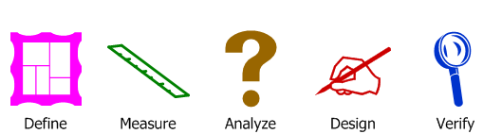
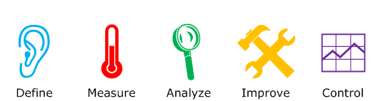
Introduction: DMADV/DMAIC
DMADV
DMAIC
Used to generate processes
Also referred as “Design for Six Sigma” (DFSS) and “Identify-Design-Optimise-Verify” (IDOV)
Used to optimise processes
Sometimes “Recognise” added to front (RDMAIC) – indicating to identify the process to be improved
https://commons.wikimedia.org/wiki/File:DMADVWebdingsI.png
DanielPenfield / CC BY-SA (https://creativecommons.org/licenses/by-sa/4.0)
https://commons.wikimedia.org/wiki/File:DMAICWebdingsI.png
DanielPenfield / CC BY-SA (https://creativecommons.org/licenses/by-sa/4.0)

Slide 15
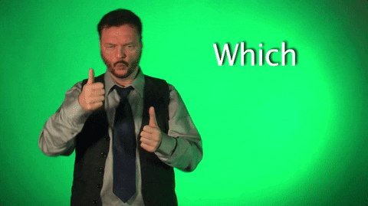
Introduction: DMADV/DMAIC
DMADV
DMAIC
Used to generate processes
Also referred as “Design for Six Sigma” (DFSS) and “Identify-Design-Optimise-Verify” (IDOV)
Used to optimise processes
Sometimes “Recognise” added to front (RDMAIC) – indicating to identify the process to be improved
https://commons.wikimedia.org/wiki/File:DMADVWebdingsI.png
DanielPenfield / CC BY-SA (https://creativecommons.org/licenses/by-sa/4.0)
https://commons.wikimedia.org/wiki/File:DMAICWebdingsI.png
DanielPenfield / CC BY-SA (https://creativecommons.org/licenses/by-sa/4.0)

Slide 16
Introduction: DMADV/DMAIC
DMADV
DMAIC
Used to generate processes
Also referred as “Design for Six Sigma” (DFSS) and “Identify-Design-Optimise-Verify” (IDOV)
Used to optimise processes
Sometimes “Recognise” added to front (RDMAIC) – indicating to identify the process to be improved
https://commons.wikimedia.org/wiki/File:DMADVWebdingsI.png
DanielPenfield / CC BY-SA (https://creativecommons.org/licenses/by-sa/4.0)
https://commons.wikimedia.org/wiki/File:DMAICWebdingsI.png
DanielPenfield / CC BY-SA (https://creativecommons.org/licenses/by-sa/4.0)

Slide 17

Introduction: DMADV/DMAIC
DMADV
DMAIC
Used to generate processes
Also referred as “Design for Six Sigma” (DFSS) and “Identify-Design-Optimise-Verify” (IDOV)
Used to optimise processes
Sometimes “Recognise” added to front (RDMAIC) – indicating to identify the process to be improved
https://commons.wikimedia.org/wiki/File:DMADVWebdingsI.png
DanielPenfield / CC BY-SA (https://creativecommons.org/licenses/by-sa/4.0)
https://commons.wikimedia.org/wiki/File:DMAICWebdingsI.png
DanielPenfield / CC BY-SA (https://creativecommons.org/licenses/by-sa/4.0)

Slide 18
Data Science Processes
Focus on Data Science

Slide 19
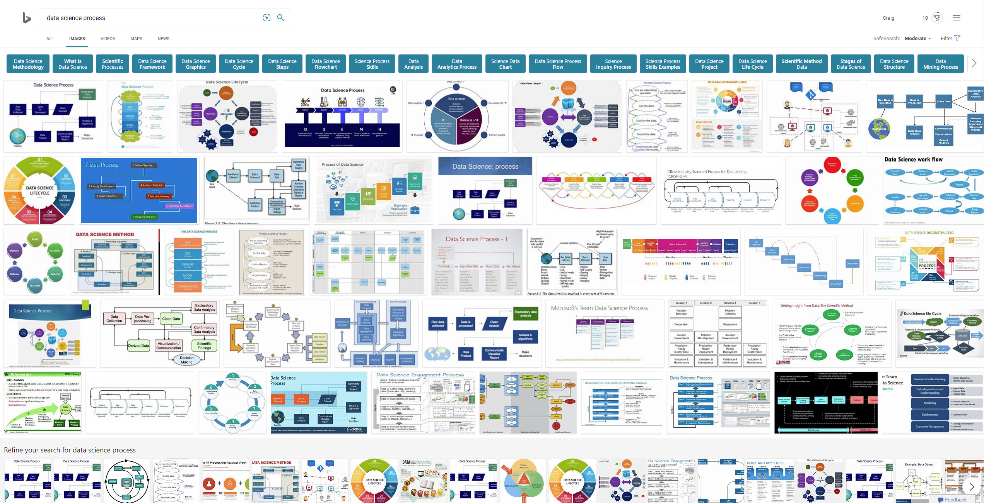
Data Science Processes: Overview

Slide 20
Data Science Processes: Overview
Insight:
Data science processes are iterative: scheduling can be tricky!

Slide 21
Specific Processes: Examples
General to Specific:
Personal Example
Microsoft Teams Data Science Process (MSTDSP)
CRoss Industry Standard Process for Data Mining (CRISP-DM)
There are many others not covered
Maturity?
…desired maturity?
Suggestions of “how data scientists do things”
Version Control, Issue Tracking, Communication, …
Tools for doing the above

Slide 22
Example: Personal Data Science Process
Define
Do
Decide
Document
Done!
Problem statement
Deliverables
Scope
Timeline
Source Data
Write/Test Code
Summary report
✓
Report to management
Confirm solution
Technical document
Slides
✓
✓
✓
✓
✓
✓
✗
✗
✓
✓
✓
✓

Slide 23
Example: Personal Data Science Process
Insight:
Processes can be improved. Start with the current state and iterate.
Define
Do
Decide
Document
Done!
Problem statement
Deliverables
Scope
Timeline
Source Data
Write/Test Code
Summary report
✓
Report to management
Confirm solution
Technical document
Slides
✓
✓
✓
✓
✓
✓
✗
✗
✓
✓
✓
✓

Slide 24
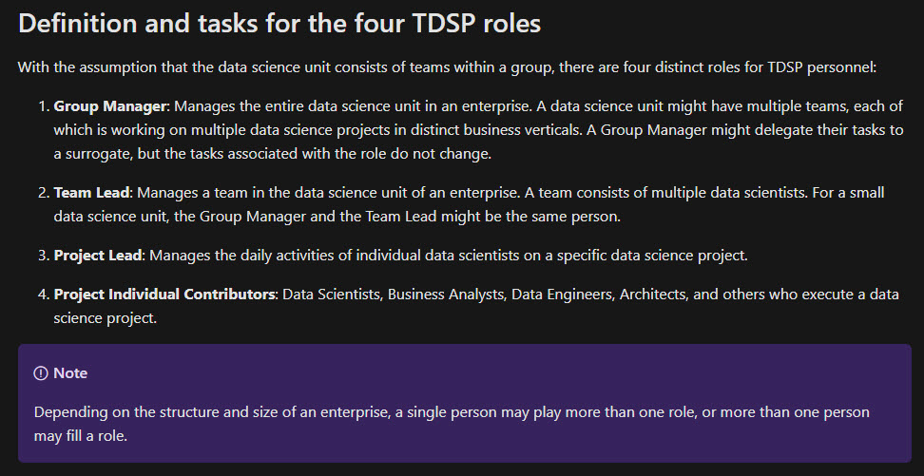
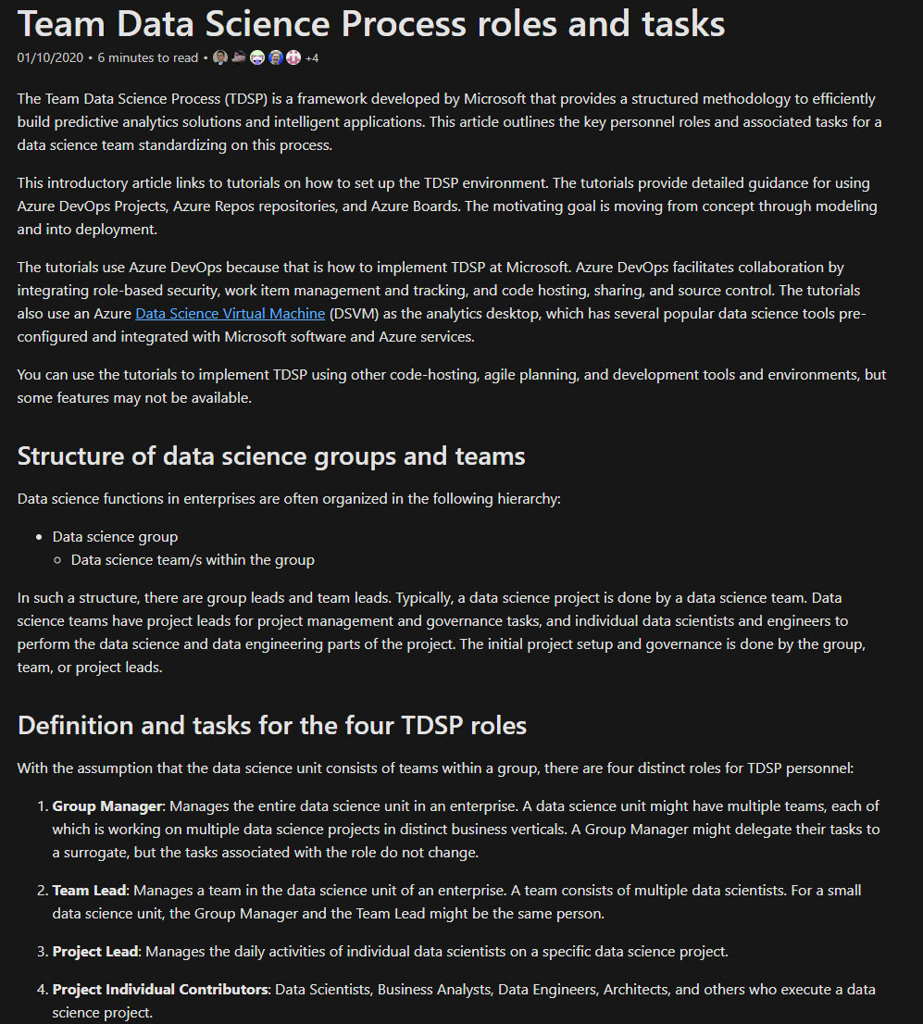
Specific Processes: MSTDSP
Microsoft Teams Data Science Process
https://docs.microsoft.com/en-us/azure/machine-learning/team-data-science-process/
Documentation, templates, code online
Updated to be performed on Azure
Includes R and Python code
GitHub repositories
Some of the R code is old

Slide 25
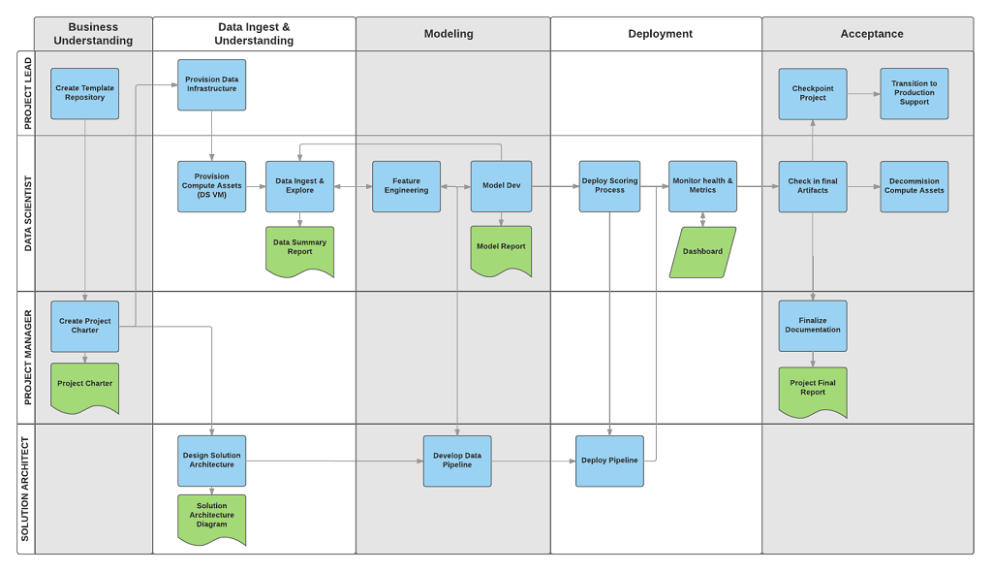
Specific Processes: MSTDSP
Skills:
Negotiations
Presentations
Typing
Processes
Microsoft Teams Data Science Process
CRISP-DM
https://docs.microsoft.com/en-us/azure/machine-learning/team-data-science-process/overview

Slide 26
Specific Processes: MSTDSP
Skills:
Negotiations
Presentations
Typing
Processes
Microsoft Teams Data Science Process
CRISP-DM
Insight:
Data science work includes more than data scientists. Optimising work for data scientists has impacts elsewhere!
https://docs.microsoft.com/en-us/azure/machine-learning/team-data-science-process/overview

Slide 27
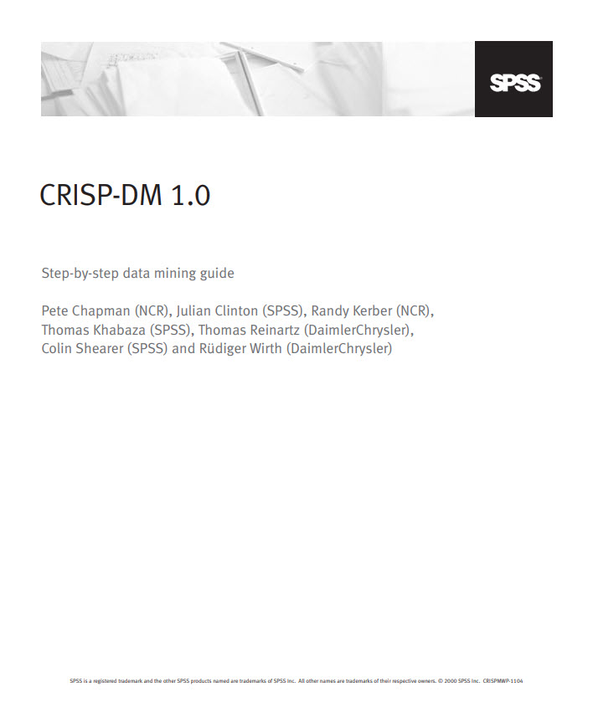

Specific Processes: CRISP-DM
CRoss Industry Standard Process for Data Mining
Data is at the centre
Step-by-Step process overview & example procedure available from IBM
Link from Wikipedia entry
Updated “Analytics Solutions Unified Method” - limited free information
BY: Kenneth Jensen [CC BY-SA 3.0],
https://upload.wikimedia.org/wikipedia/commons/b/b9/CRISP-DM_Process_Diagram.png

Slide 28
Specific Processes: CRISP-DM
CRoss Industry Standard Process for Data Mining
Step-by-Step process guide available from IBM
Link from Wikipedia entry
Updated “Analytics Solutions Unified Method” - limited free information
Data is at the centre
Insight:
Data science feeds into business understanding. Are stakeholders ready to have views challenged?
BY: Kenneth Jensen [CC BY-SA 3.0],
https://upload.wikimedia.org/wikipedia/commons/b/b9/CRISP-DM_Process_Diagram.png

Slide 29
Example Application
Relevant to all of you!

Slide 30

Simple Question
Why are you here?

Slide 31
Example Process Developments
Define | Measure | Analyse | Design | Verify
Get a job | # jobs | Steps missing? | (Needs more thought) | Count jobs?

Slide 32
Example Process Developments
Define | Measure | Analyse | Design | Verify
Get a job | # jobs | Steps missing? | (Needs more thought) | Count jobs?
Meet people | # people met | Repeats? | Data stores? | (Future talks)

Slide 33
Example Process Developments
Define | Measure | Analyse | Design | Verify
Get a job | # jobs | Steps missing? | (Needs more thought) | Count jobs?
Meet people | # people met | Repeats? | Tasks to meet people? | (Future talks)
Enjoyment | Amount enjoyed? | Quantification? | (Depends on M&A) | (Future talks)
Learn | Amount learned? | Quantification? | (Depends on M&A) | (Future talks)
What can I measure?

Slide 34
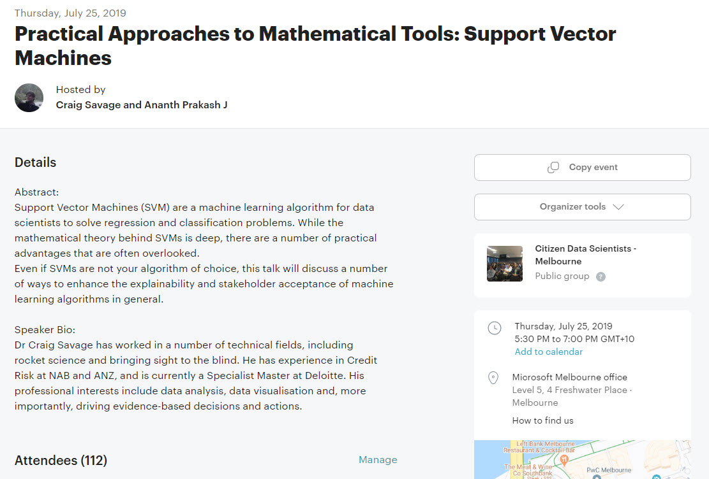
Example Process Measurements
Last meetup presentation
41 sign-ins

Slide 35
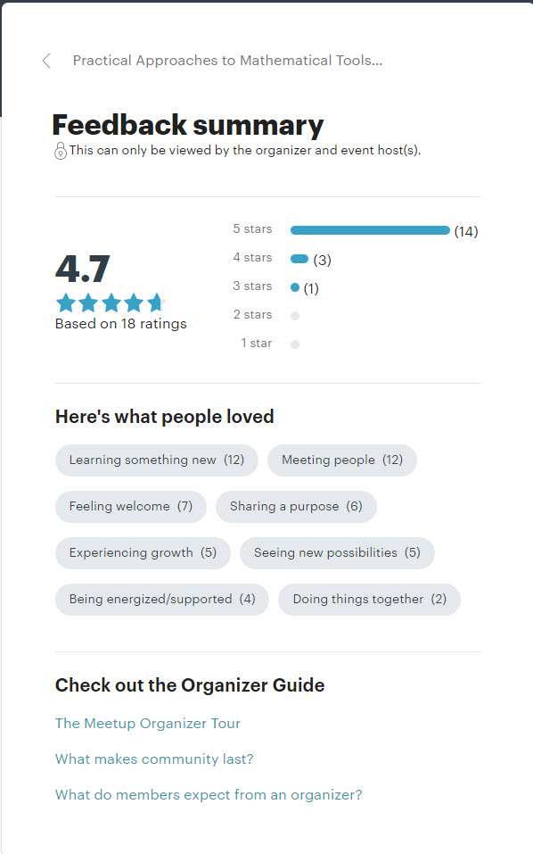
Example Process Measurements
Last meetup presentation
41 sign-ins
Feedback survey
Learning and Meeting People top (12 each, 2/3 of responses)
Doing things together (2)?

Slide 36
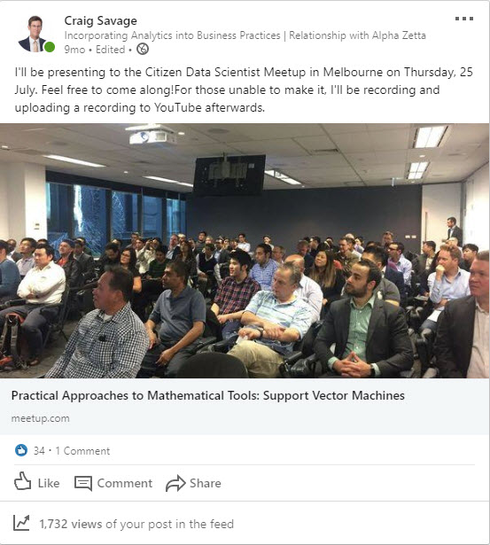
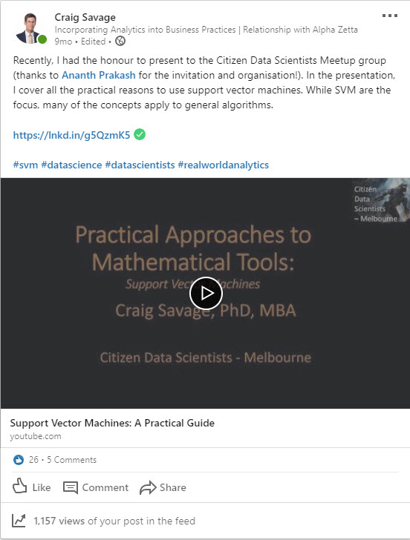
Example Process Measurements
Last meetup presentation
41 sign-ins
Feedback survey
Learning and Meeting People top (12 each, 2/3 of responses)
Doing things together (2)?
External engagement:
LinkedIn

Slide 37
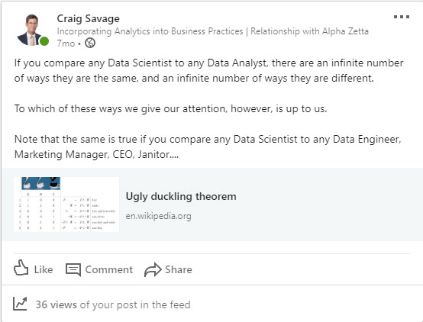
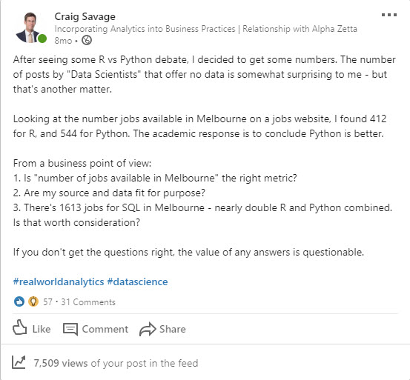
Example Process Measurements
Last meetup presentation
41 sign-ins
Feedback survey
Learning and Meeting People top (12 each, 2/3 of responses)
Doing things together (2)?
External engagement:
LinkedIn

Slide 38
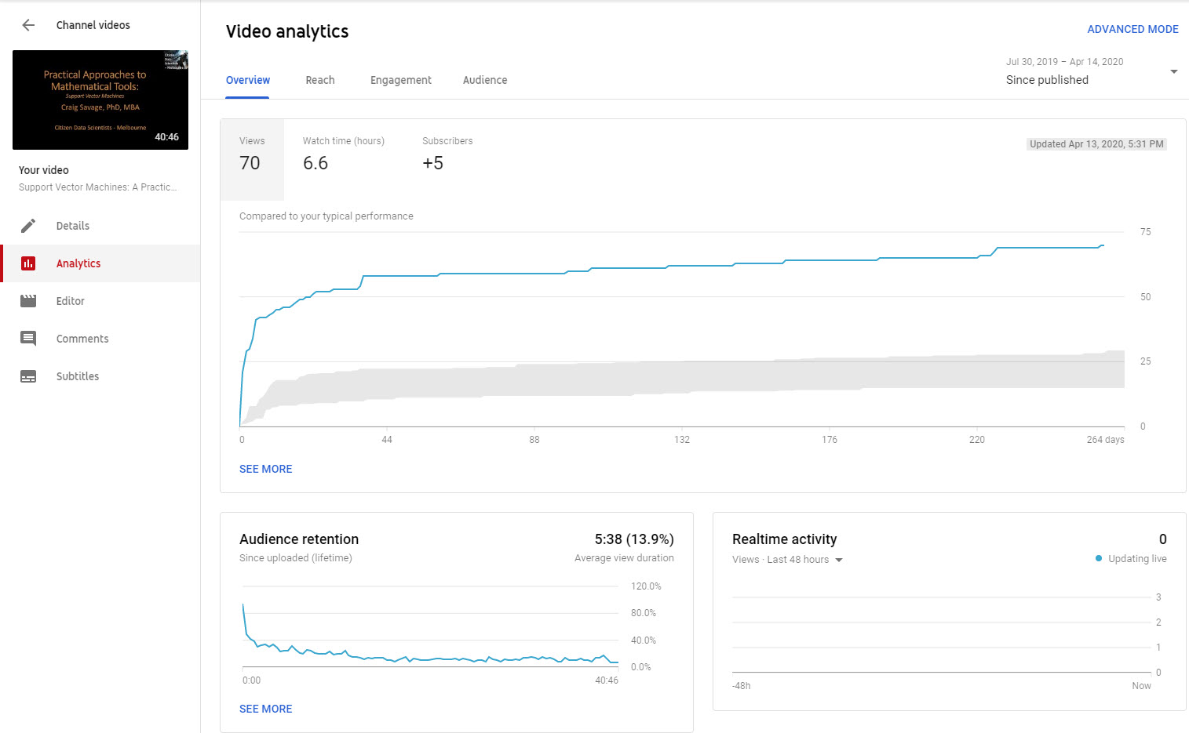
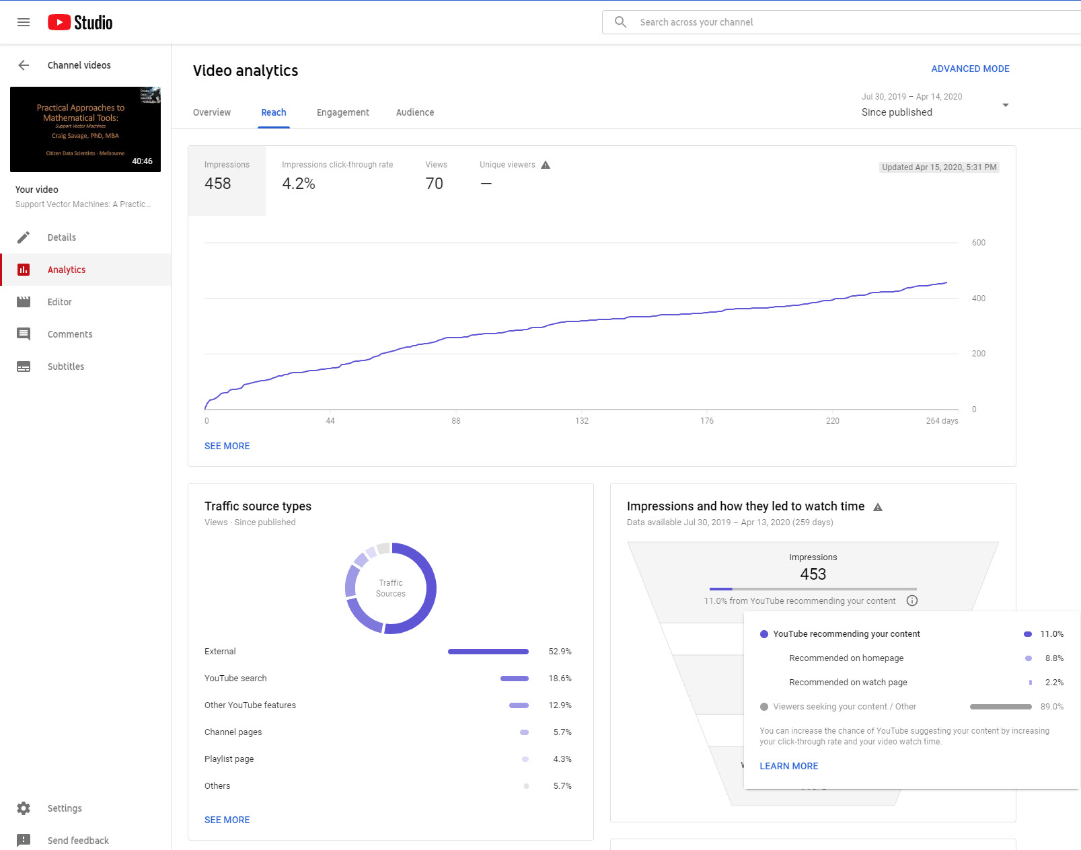
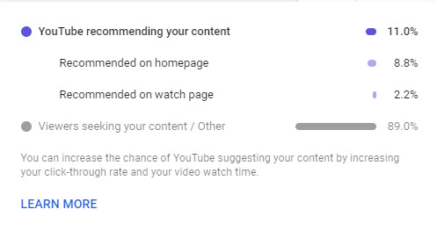
Example Process Measurements
Last meetup presentation
41 sign-ins
Feedback survey
Learning and Meeting People top (12 each, 2/3 of responses)
Doing things together (2)?
External engagement:
LinkedIn
YouTube

Slide 39
Data Science Process Maps, Revisited

Slide 40

Example Process Developments
New Data
Insufficient Performance
https://docs.microsoft.com/en-us/azure/machine-learning/team-data-science-process/overview

Slide 41

Example Process Developments
https://docs.microsoft.com/en-us/azure/machine-learning/team-data-science-process/overview
BY: Kenneth Jensen [CC BY-SA 3.0],
https://upload.wikimedia.org/wikipedia/commons/b/b9/CRISP-DM_Process_Diagram.png

Slide 42
Data Science on Processes
Previous slides describe Data Science Processes
And there are more!
Some have irrelevant/trivial tasks
Application shows versatility of process designs
Lead to similar outcomes
Add measurements to processes
Timings, outputs, etc
Revise data and measurements
By Sally Godfrey - What is CMMI ?, Public Domain, https://commons.wikimedia.org/w/index.php?curid=16790845

Slide 43
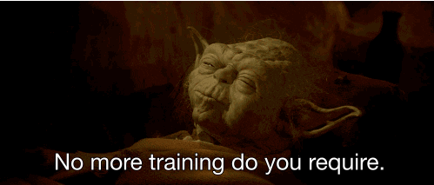
Data Science on Processes
Previous slides describe Data Science Processes
And there are more!
Some have irrelevant/trivial tasks
Application shows versatility of process designs
Lead to similar outcomes
Add measurements to processes
Timings, outputs, etc
Revise data and measurements
By Sally Godfrey - What is CMMI ?, Public Domain, https://commons.wikimedia.org/w/index.php?curid=16790845

Slide 44
Summary
…and further information

Slide 45
Summary
Introduction to processes
Definition
Related terms
Documentation
Maturity
Examples of Data Science Processes
No single answer!
Example of application to relevant problem

Slide 46
Summary
Introduction to processes
Definition
Related terms
Documentation
Maturity
Examples of Data Science Processes
No single answer!
Example of application to relevant problem
Process to Analyse your Data
VS
Data to Analyse your Process

Slide 47
Recommendations
Business Acumen
What are the business metrics? Dollars, engagement, etc?
Lean, Agile, Six Sigma, Management by Objectives, Total Quality Management
Process or Procedure Problem?
Generality or Specifics?
Ignorance: “Don’t know how the sausage is made”
Innocent or Intentional?
Can be applied to (almost?) anything
Don’t just do things: Think about then execute the process

Slide 48
Recommendations
Business Acumen
What are the business metrics? Dollars, engagement, etc?
Lean, Agile, Six Sigma, Management by Objectives, Total Quality Management
Process or Procedure Problem?
Generality or Specifics?
Ignorance: “Don’t know how the sausage is made”
Innocent or Intentional?
Can be applied to (almost?) anything
Don’t just do things: Think about then execute the process

Slide 49
Where you can find me
Online:
https://www.docsavagesolutions.com
LinkedIn (Craig “Doc” Savage):
https://www.linkedin.com/in/craig-doc-savage
YouTube (Craig Savage):
https://goo.gl/Mjp6Sc
Kaggle (DocSavage):
https://www.kaggle.com/docsavage
GitHub (SavageDoc)
https://github.com/SavageDoc/

Slide 50
Acknowledgements
Microsoft
Ananth Prakash for the invitation and hosting this event (virtually!)
Contributors to Medium:
Pedro Robledo: Processes, Procedures, Work Instructions
Contributors to Wikimedia
Sally Godfrey: CMMI
Daniel Penfied: DMADV, DMAIC
Kenneth Jensen: CRISP-DM
Giphy.com
So many gifs, so little time….

Slide 51

Acknowledgements
Microsoft
Ananth Prakash for the invitation and hosting this event (virtually!)
Contributors to Medium:
Pedro Robledo: Processes, Procedures, Work Instructions
Contributors to Wikimedia
Sally Godfrey: CMMI
Daniel Penfied: DMADV, DMAIC
Kenneth Jensen: CRISP-DM
Giphy.com
So many gifs, so little time….

Slide 52
Thank you
Data Science Processes
Presented by Craig “Doc” Savage

Slide 53
Questions?

